Slide 1

Week 5
Security
Fundamentals of IoT
Dr. Eoin Rogers (eoin.rogers@tudublin.ie)

Slide 2
Lesson Outline
Why is security important?
How can we implement secure IoT devices
Emphasis on cryptography and other common-sense approaches to dealing with security

Slide 3
Security in IoT devices
Security is an essential part of modern networking, but is unfortunately often overlooked by IoT vendors!
This has lead to major security breaches:
  Ring cameras
  Attacks on St. Jude’s cardiac devices
  Mirai botnet

Slide 4
Basic security practices
By following certain practices, we can increase the security of our devices

Slide 5
Common IoT security issues
Default passwords
Single level of access control
Large attack surfaces
Old software
Lack of encryption
Trusted computing
Poor responses from vendors when intrusions are found

Slide 6
Default passwords
When a user first logs in, make them change the password!
Enable two-factor authentication by default
  Do allow users to disable it, but an important security principle is to make the defaults secure whenever possible!

Slide 7
Single level of access control
Seperate normal and administrative users
  This can be challenging, because IoT devices often have limited functionality!
Implement stricter security for admin functions and users

Slide 8
Minimise attack surfaces
Present fewer targets that an attacker can exploit
  Do you really need 20 ports open on your IoT device?
  Do you really need to run a full operating system?
You could argue that IoT as a whole is a violation of this principle!

Slide 9
Old software
Old software is often filled with vulnerabilities
Only use old software if you are sure it is safe!
“My device is low-end and constrained” is not a very good excuse!
Don’t re-invent the wheel – writing your own security code makes your system more vulnerable, not less!

Slide 10
Encryption
Try to encrypt anything that could potentially be sensitive or private
  Maybe even data that isn’t private, in order to protect against clever side channels or network analysis!
Three types of encryption: symmetric, asymmetric and hashing

Slide 11
Encryption
Actually, encryption is important enough that we should spend some time talking about it!

Slide 12
Symmetric ciphers
Sender and reciever need to share the same key in advance of communication taking place
Same key used to encrypt and decrypt
Examples:
  AES/Rijndael
  Blowfish and Twofish

Slide 13
Asymmetric ciphers
Two keys exist: a public key used to encrypt data, and a private key to decrypt it
The receiver generates the two keys, and only makes the public key public. It is useless for decrypting
Examples:
  RSA
  Eliptic curve algorithms

Slide 14
RSA overview
Generate two (large) prime numbers, p and q
n = p * q
λ = lcm(p – 1, q – 1)
Pick a number e between 1 and λ such that the gcd(e, λ) = 1
Pick a number d such that (e * d) % n == 1
Use n and e as a public key, and n and d as a private key

Slide 15
RSA usage
To encrypt the plaintext p:
  c = pow(p, e) % n
To decrypt the ciphertext c:
  p = pow(c, d) % n

Slide 16
Hashing
Basically irreversible encryption – we can go from plaintext to ciphertext, but not the reverse
Commonly used to store passwords
Examples:
  SHA-2 (128/256/512)
  SHA-3 (256/384/512)

Slide 17
Encryption on the Pico
Yes, there is a library that implements AES!

Slide 18
Modes of operation
One complexity in the real world: if we use a block cipher with a block size of 256 bits, how do we encrypt more than 256 bits of data?
  You would assume we pad it to have a length which is a multiple of 256 bits and split it into blocks
  Do people think this will work?

Slide 19
Modes of operation
One complexity in the real world: if we use a block cipher with a block size of 256 bits, how do we encrypt more than 256 bits of data?
  You would assume we pad it to have a length which is a multiple of 256 bits and split it into blocks (ECB mode)
  Do people think this will work?

Slide 20

Electronic code book doesn’t work!
Using ECB can leak a lot of information about the underlying data!

Slide 21
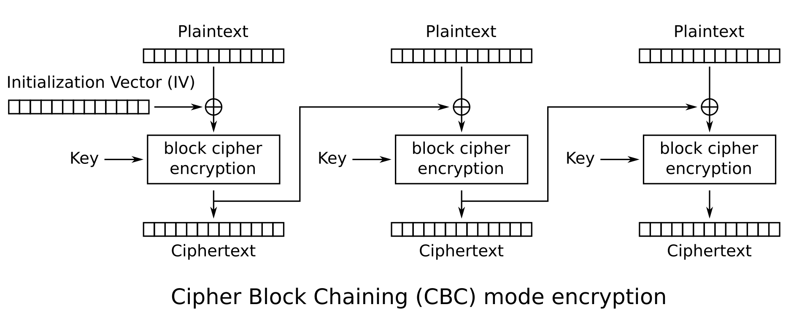
Cipher-block chaining (CBC)

Slide 22
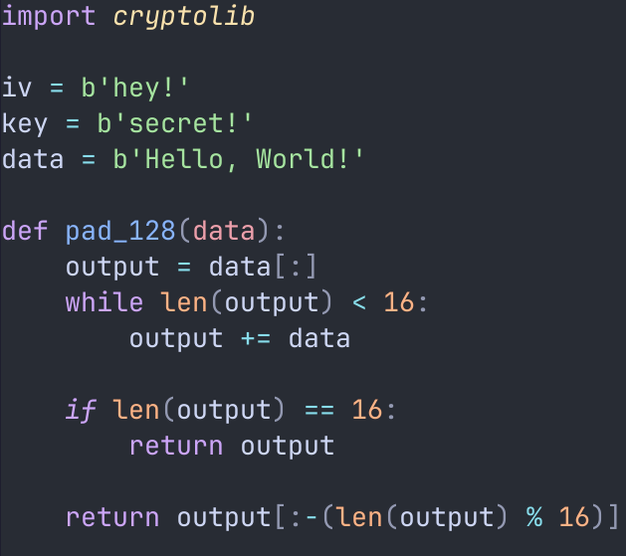
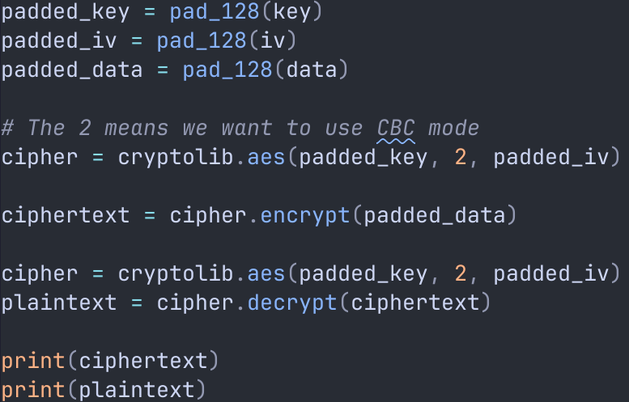
AES in MicroPython

Slide 23
Back to the main lecture
That’s enough talk about encryption!

Slide 24
Trusted computing
Use cryptographic functions to ensure that firmware hasn’t been tampered or modified
  Somewhat controversial!
Secure Boot on PCs – a similar system called the Device Identifier Composition Engine (DICE) is used for IoT

Slide 25
Vendor responses to security incidents
How it is supposed to work:
  Have a plan in place detailing how to respond to security breaches
  Monitor network traffic to detect suspicious activity!
  Inform customers when a breach occurs
  Update device firmware
  Plan for process changes, deal with human factors!

Slide 26
Summary
Security is a common issue in IoT devices, so it is something that needs special attention
There is no such thing as 100% secure, but there is such a thing as not worth dealing with (attackers follow the path of least resistance)
Use proper encryption!

Slide 27
<number>
That’s all for this week
Thanks for your attention!

